Slide 1
Conditional probability and Bayes: updating beliefs with evidence
A test finds 90% of sick people and wrongly flags 10% of healthy people. You test positive. How likely are you sick?
Mathematics for AI and Machine Learning | Session 15 of 18 | Probability and statistics
KLAi Professional Learning | Jotham Martin Wambi
Notes:
Welcome to Session 15, the last session on probability itself. Today is about updating a belief when evidence arrives. We start with a famous surprise: a test that finds 90 percent of sick people, and wrongly flags 10 percent of healthy people, says positive, and the chance you are sick is under 10 percent.
Then we turn the same rule into a small spam filter. We close with how to read a probability that an AI model gives you.

Slide 2



Today in one view: what you will leave with
By the end of today you can
Read joint, marginal and conditional probabilities from a table of counts, test for independence, and say what conditional independence means
Apply Bayes theorem with natural frequencies, naming the prior, likelihood and posterior
Build a small Naive Bayes spam classifier by hand and in code, and read a model probability with care
Notes:
By the end of today you can do three things. Read joint, marginal and conditional probabilities from a table of counts, test whether two events are independent, and say what it means for two words to be independent within a class. Apply Bayes theorem using natural frequencies, and name the prior, the likelihood and the posterior.
And build a small Naive Bayes spam filter by hand and in code, and then read a probability from a model with care. That includes the caution that a fluent answer from a language model is not a probability that it is true.

Slide 3
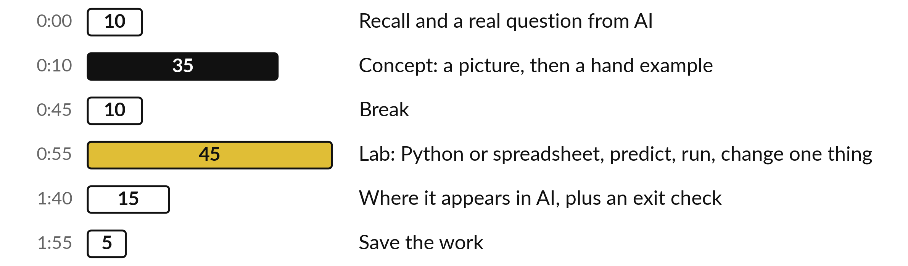
Your two hours: counts,
Bayes, a spam filter, then AI
Counts first, then Bayes with natural frequencies, then a spam filter by hand and in the lab.
Notes:
We start with ten minutes of recall from Session 14 and the question about a positive medical test. Then thirty-five minutes of concepts, a picture first and a hand example after it. After the break you spend forty-five minutes in the lab, in Python or in a spreadsheet, on the same numbers.
We finish with where this appears in AI, an exit check, and saving your work.

Slide 4
Three questions from last time
1. Why can the same question get a different answer from a chat model?
2. What does a standard error measure?
3. An A/B test gives p = 0.039. What does that mean?
Answer aloud first. Then we check together.
Notes:
Three quick questions from Session 14. Answer aloud first, and then we check together. It is a warm-up to bring last time back.
Question one. Why can the same question get a different answer from a chat model? Take a moment.
A good answer is this. The next word is drawn at random from its probabilities. A new random number u can land in a different slice.
Question two. What does a standard error measure? Say it to yourself first.
A good answer is this. How much a sample mean wanders from sample to sample: sigma divided by the square root of n.
Question three. An A/B test gives p = 0.039. What does that mean? Think about your own task as you answer.
A good answer is this. A gap this large would be rare if there were truly no difference. It is not a 3.9% chance that the feature does nothing.
If an answer was missing, do not worry. Your notes from last class have it. Now to today.

Slide 5
Answers to the three questions from Session 14
Question | Short answer
Why can the same question get a different answer from a chat model? | The next word is drawn at random from its probabilities. A new random number u can land in a different slice.
What does a standard error measure? | How much a sample mean wanders from sample to sample: sigma divided by the square root of n.
An A/B test gives p = 0.039. What does that mean? | A gap this large would be rare if there were truly no difference. It is not a 3.9% chance that the feature does nothing.
If an answer surprised you, look back at Session 14 before the lab.
Notes:
Three short answers. The next word is drawn at random from its probabilities, so a new random number can land in a different slice and give a different word. The standard error measures how much a sample mean wanders from sample to sample, and it is sigma over the square root of n.
And a p-value of 0.039 says that a gap this large would be rare if there were truly no difference. It does not say there is a 3.9 percent chance that the feature does nothing. Check your own answers against these.

Slide 6





Words we use today
Word | What it means
Conditional probability | P(A | B): the probability of A once we know B happened.
Conditional independence | Two words are independent within each class (spam, ham), though not overall. Independence itself is from Session 13.
Prior, likelihood and posterior | The belief before evidence, the chance of the evidence if the hypothesis is true (for a test: its sensitivity), and the updated belief.
Bayes' theorem | The rule P(H | E) = P(E | H) P(H) / P(E): the posterior from the likelihood, the prior and the evidence.
Naive Bayes classifier | A classifier that multiplies per-word likelihoods, assuming the words are independent within each class.
Notes:
Five words for today. I give the plain meaning of each, and we use every one of them before the end of the session.
Conditional probability. P(A | B): the probability of A once we know B happened.
Conditional independence. Two words are independent within each class (spam, ham), though not overall. Independence itself is from Session 13.
Prior, likelihood and posterior. The belief before evidence, the chance of the evidence if the hypothesis is true (for a test: its sensitivity), and the updated belief.
Bayes' theorem. The rule P(H | E) = P(E | H) P(H) / P(E): the posterior from the likelihood, the prior and the evidence.
Naive Bayes classifier. A classifier that multiplies per-word likelihoods, assuming the words are independent within each class.

Slide 7
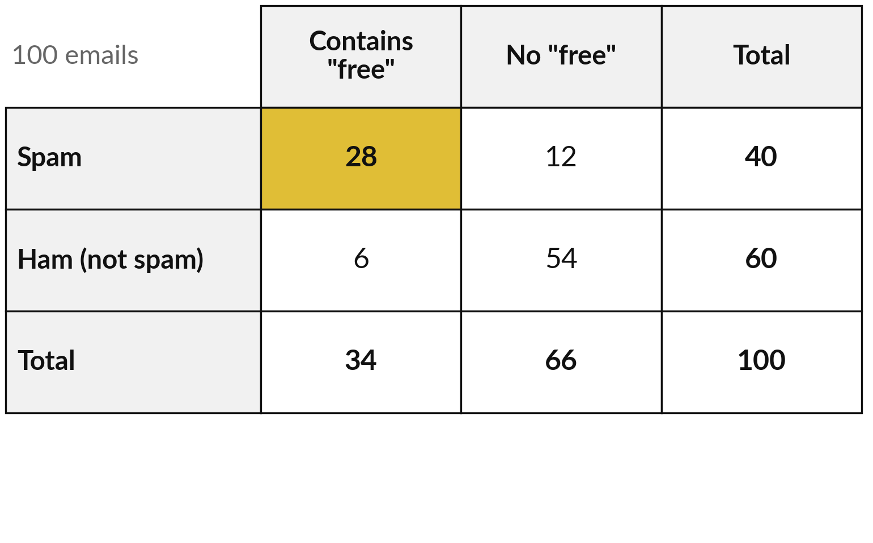
A table of counts shows joint
and marginal probabilities
Illustrative: 100 emails, 40 spam and 60 ham, sorted by whether they contain the word "free".
Joint probability: P(spam and free) = 28 / 100 = 0.28 (gold).
Marginal probability: one event on its own, from a row or column total. P(free) = 34 / 100 = 0.34.
P(spam) = 40 / 100 = 0.40.
Notes:
A small table of counts, illustrative, made up to show the arithmetic. One hundred emails, forty of them spam and sixty ham, and in each row we count how many contain the word free. The gold cell is a joint probability: twenty-eight emails are both spam and contain free, so the probability of both is 0.28.
A marginal probability comes from a total in the margin of the table. Thirty-four emails contain free, so the marginal probability of free is 0.34. Forty are spam, so the marginal probability of spam is 0.40. What is the marginal probability of ham?

Slide 8
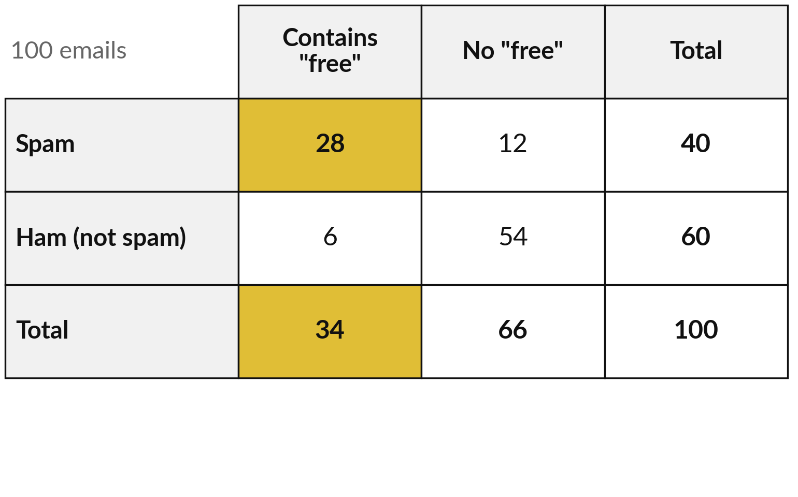
A conditional probability looks only at
the emails where the condition holds
Given that an email contains "free", only the 34 emails in the first column matter.
P(spam | free) = 28 / 34 = 0.8235.
P(free | spam) = 28 / 40 = 0.70.
The two are different questions with different answers.
Notes:
A conditional probability is written P of A given B, with a vertical bar. It means: restrict attention to the cases where B is true, and ask how often A is true among them. Suppose an email contains the word free. Only the 34 emails in the first column remain, and 28 of them are spam, so P of spam given free is 28 over 34, 0.8235.
Turn it around. Among the 40 spam emails, 28 contain free, so P of free given spam is 0.70. The two numbers differ, and mixing them up is the commonest mistake in this topic.

Slide 9
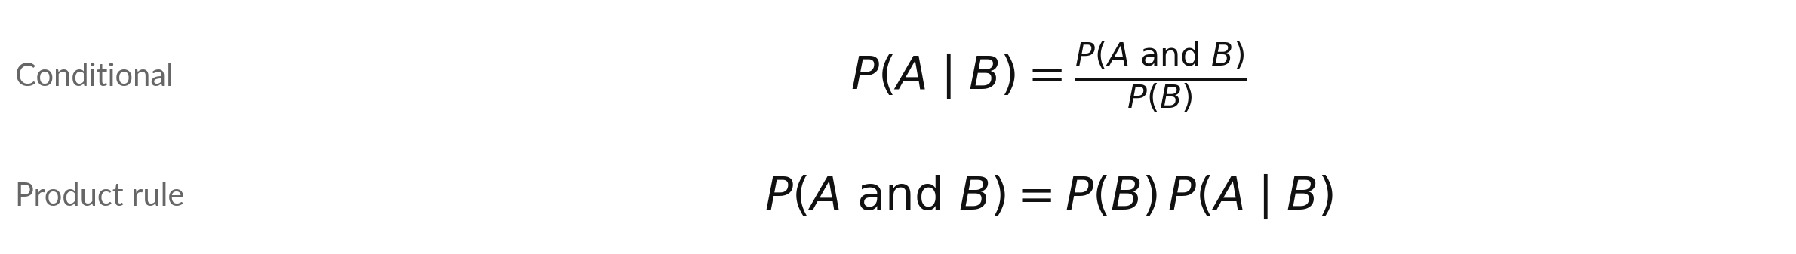
Joint, marginal and conditional probability
Symbol | What it means | In our data
P(A and B) | The joint probability: both events happen. | P(spam and free) = 0.28
P(B) | The marginal probability of the condition. | P(free) = 0.34
P(A | B) | The conditional probability: A given B. | 0.28 / 0.34 = 0.8235
The product rule is the same formula rearranged: 0.34 × 0.8235 = 0.28.
Notes:
In formulas, the conditional probability of A given B is the joint probability of A and B, divided by the marginal probability of B. That is the same as our counting argument, with the counts divided by 100. For our emails, 0.28 divided by 0.34 gives 0.8235. Rearrange it and you get the product rule: the joint probability is P of B times P of A given B.
Check it: 0.34 times 0.8235 is 0.28. This rule is the engine behind Bayes theorem.

Slide 10
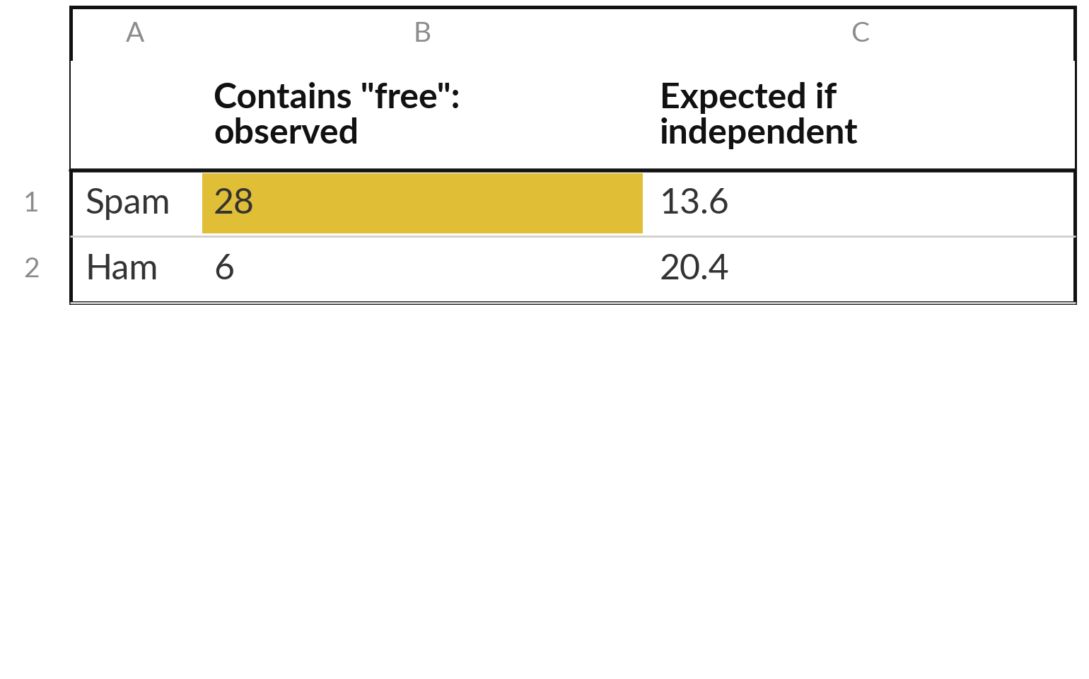
Recall independence from Session 13: "free" and
spam fail the test, so the word carries information
Independent (Session 13): P(A and B) = P(A) × P(B). Test it on the counts.
If independent: P(spam) × P(free) = 0.40 × 0.34 = 0.136, so 13.6 emails.
Observed: 28 emails. Far more than 13.6.
So the word carries information about spam. A filter can use it.
Notes:
Session 13 defined independence with two dice: knowing one tells you nothing about the other, so the probability of both is the product. Today we use it as a test. Independent is different from mutually exclusive: independent events can happen together. Test it on our emails. If free and spam were independent, we would expect 0.4 times 0.34 of the 100 emails to be spam containing free, which is 13.6.
We actually observe 28. The gap tells us the word is informative, which is exactly why a spam filter can use it.

Slide 11
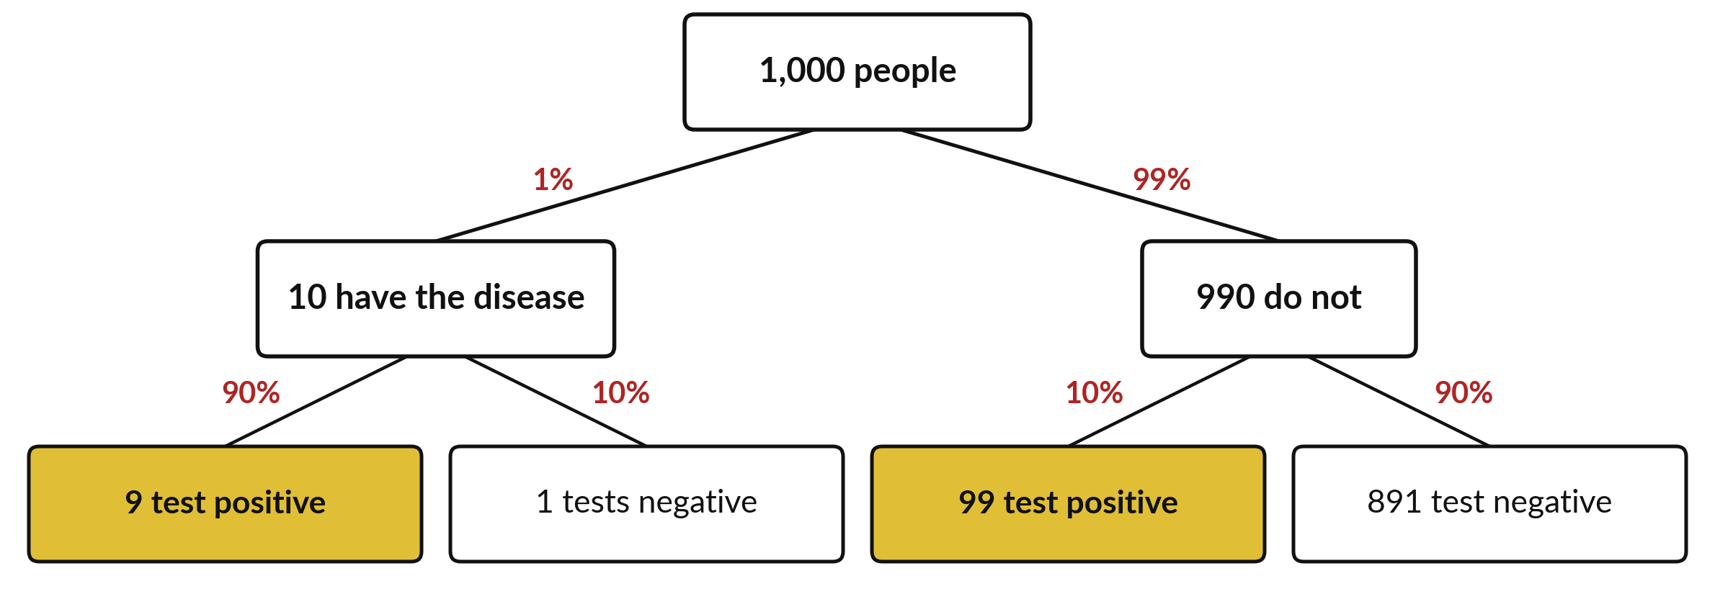
Natural frequencies: of 1,000 people, 9 sick people
test positive and 99 healthy people test positive
Illustrative: 1% sick. Sensitivity 90% (sick found). False positive rate 10% (healthy flagged).
Notes:
The famous surprise, with natural frequencies. Natural frequencies means we count people instead of juggling percentages. All numbers are illustrative. Take a thousand people. One percent are sick, that is ten. The test catches ninety percent of them, a rate called the sensitivity, so nine test positive. Of the 990 healthy people, ten percent are wrongly flagged, which is 99 people.
That ten percent is the false positive rate. Now you test positive. You are one of the gold boxes: 9 plus 99, 108 people. Only 9 of them are sick. What fraction is that?

Slide 12
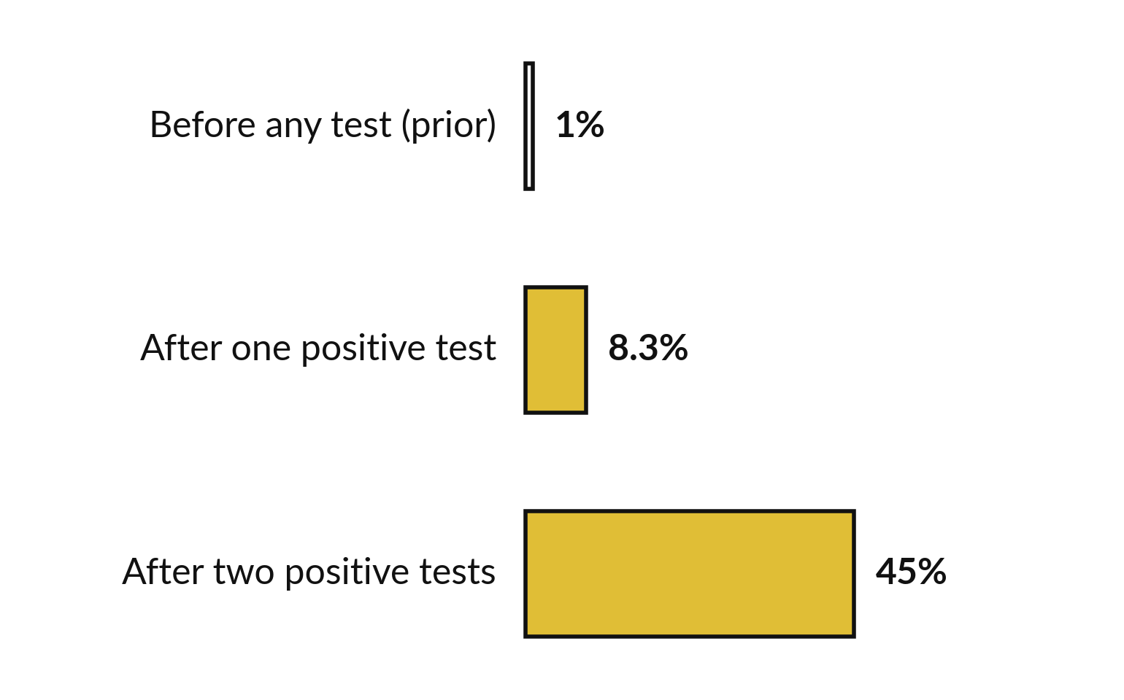
A positive test moves the belief from 1%
to 8.3%, and a second positive test to 45%
After one positive test: 9 sick of 108 positives, 0.0833. Gold: after the evidence.
Most positives come from the many healthy people.
Two positives: 45%, if the tests err independently given sick or healthy.
Evidence updates a belief.
Notes:
The answer as a picture. Before the test, your chance of being sick is the prevalence, 1 percent. After one positive test it is 9 out of 108, which is 8.3 percent. Most positive results come from the huge group of healthy people, even though each has only a ten percent chance of a false alarm.
If you take a second, independent test and it is positive too, the belief rises to 45 percent. This assumes that, for a sick person and for a healthy person alike, the second test errs independently of the first. That is a conditional independence, and repeat tests on the same person often break it.
Evidence updates a belief. It does not replace the prior. That is Bayes theorem in action.

Slide 13
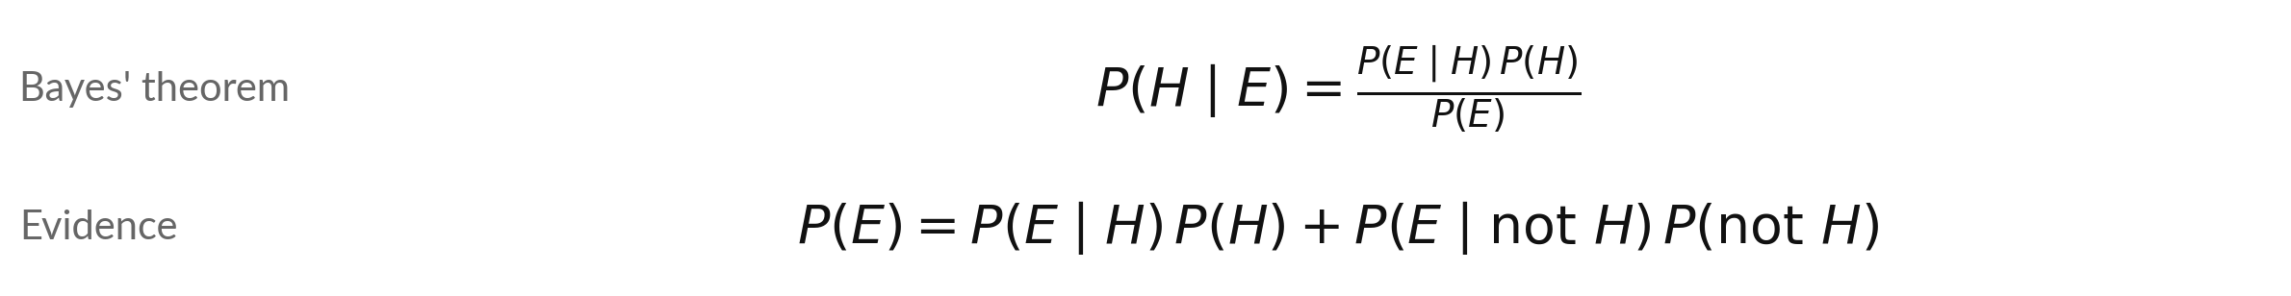
Bayes' theorem: prior, likelihood,
evidence and posterior
Symbol | What it means | In our data
P(H) | Prior: belief in the hypothesis H (sick) before the evidence E (a positive test). | 0.01
P(E | H) | Likelihood (here the sensitivity): how likely the evidence is if H is true. | 0.90
P(E) | Marginal likelihood of the evidence, also just called the evidence: 0.9 × 0.01 + 0.1 × 0.99. | 0.108
P(H | E) | Posterior: the updated belief after the evidence. | 0.009 / 0.108 = 0.0833
The same 9 / 108 as the natural frequencies, with probabilities instead of counts.
Notes:
The rule with proper names. We want the posterior, P of H given E, the belief after the evidence. It equals the likelihood, P of E given H, times the prior, P of H, divided by the evidence, P of E. The evidence is the overall chance of a positive test: ninety percent of one percent, plus ten percent of ninety-nine percent, which is 0.108.
The top is 0.9 times 0.01, which is 0.009. Divide, and you get 0.0833. It is the same 9 out of 108 you got by counting people. In Session 16 the word likelihood is used with the data fixed and the parameter varying.

Slide 14
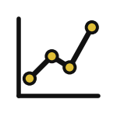

The most common mistake is
to swap P(E | H) and P(H | E)
P(positive | sick) = 0.90
P(sick | positive) = 0.083
How well the test finds sick people
The likelihood, set by the test maker
What you want to know after a positive result
The posterior, which also needs the prior
Ignoring the prior (the base rate) is called base rate neglect.
Notes:
The mistake in one slide. On the left, ninety percent is the probability of a positive test given that you are sick. That is the likelihood, and it describes the test. On the right, 8.3 percent is the probability that you are sick given a positive test. That is the posterior, and it also depends on how rare the disease is.
People often read the first number as if it were the second. Forgetting the base rate in this way is called base rate neglect. Which one does a patient actually care about?

Slide 15
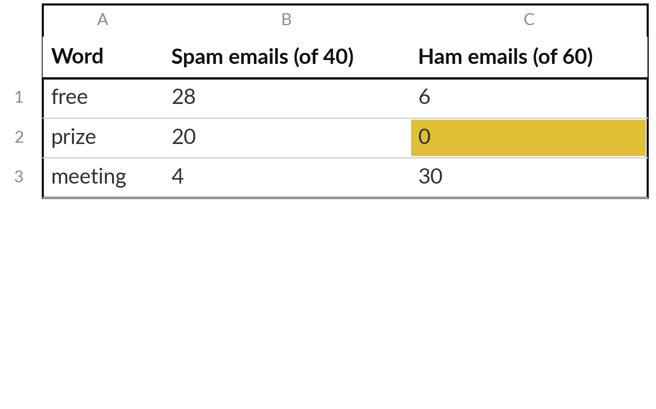
A tiny table of word counts is all
a Naive Bayes spam filter needs
Illustrative training counts: how many emails of each class contain each word.
Prior: P(spam) = 40 / 100 = 0.4 and P(ham) = 0.6.
"free" and "prize" point to spam. "meeting" points to ham.
The gold zero is a problem: no ham email contained "prize".
Notes:
The training data for a tiny spam filter, illustrative. Out of 100 training emails, 40 are spam and 60 are ham. For three words we count how many emails of each class contain the word. The priors come straight from the class sizes: 0.4 for spam and 0.6 for ham.
Free and prize lean to spam, and meeting leans to ham. Now look at the gold zero. No ham email contained prize. That sounds harmless, but a zero will wreck a multiplication, as we are about to see.

Slide 16
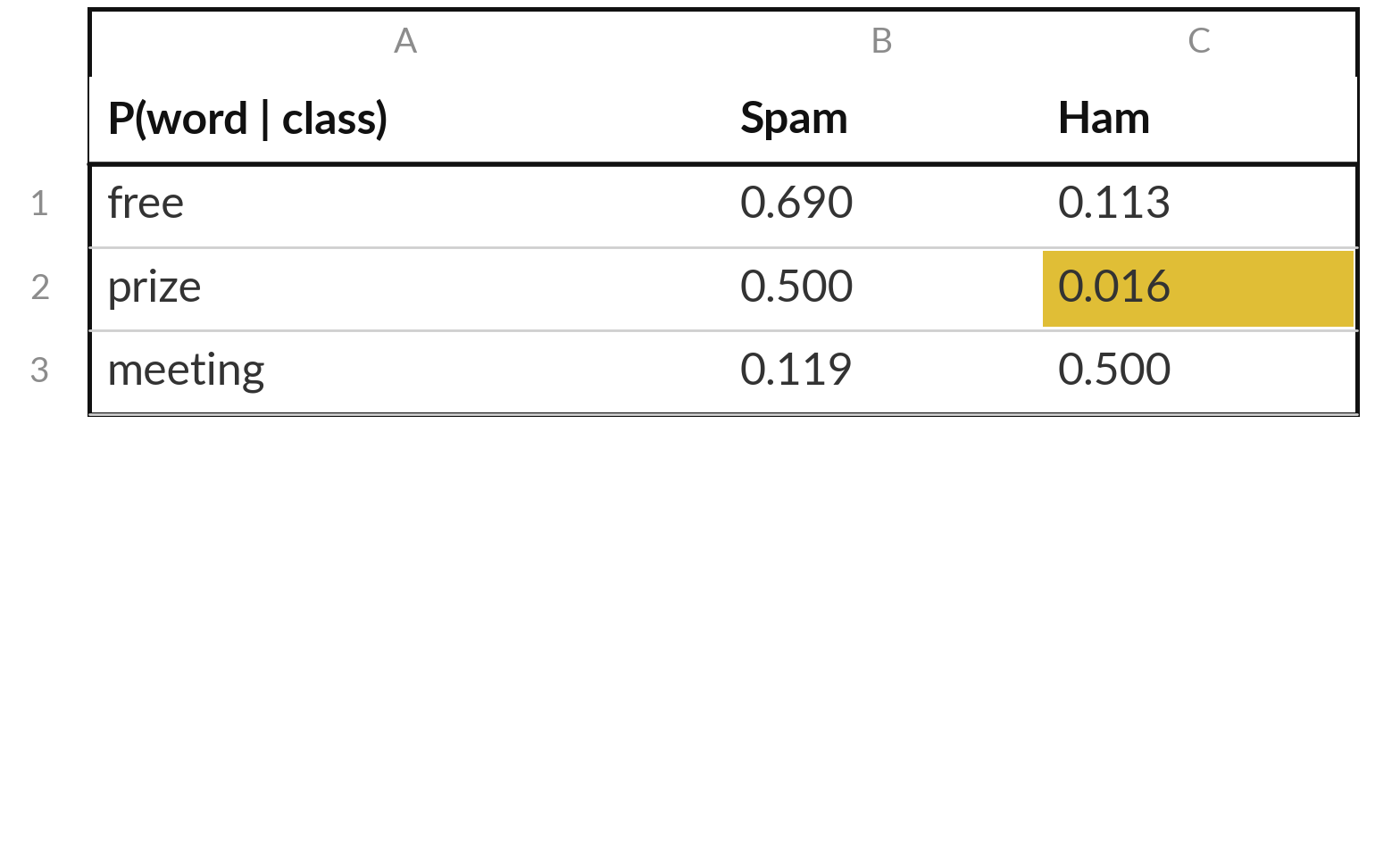
Add-one smoothing turns each count
into a likelihood and removes the zero
Add-one (Laplace) smoothing: likelihood = (count plus 1) / (emails in the class plus 2).
+ 2: present and absent each get one extra count.
prize, ham: (0 + 1) / (60 + 2) = 0.016.
A zero would make it impossible for any email with "prize" to be ham.
Notes:
To turn counts into likelihoods we use a small trick called add-one smoothing, also known as Laplace smoothing. Add one to the count, and add two to the class size, because each word has two outcomes, present or absent, and each gets one imaginary extra email. For free in spam that gives 29 over 42, which is 0.690.
For prize in ham, instead of zero we get 1 over 62, which is 0.016: small but not zero. Without smoothing, one unseen word would force the ham probability to exactly zero, and no other evidence could ever win it back. A filter should never be that certain from a few emails.

Slide 17
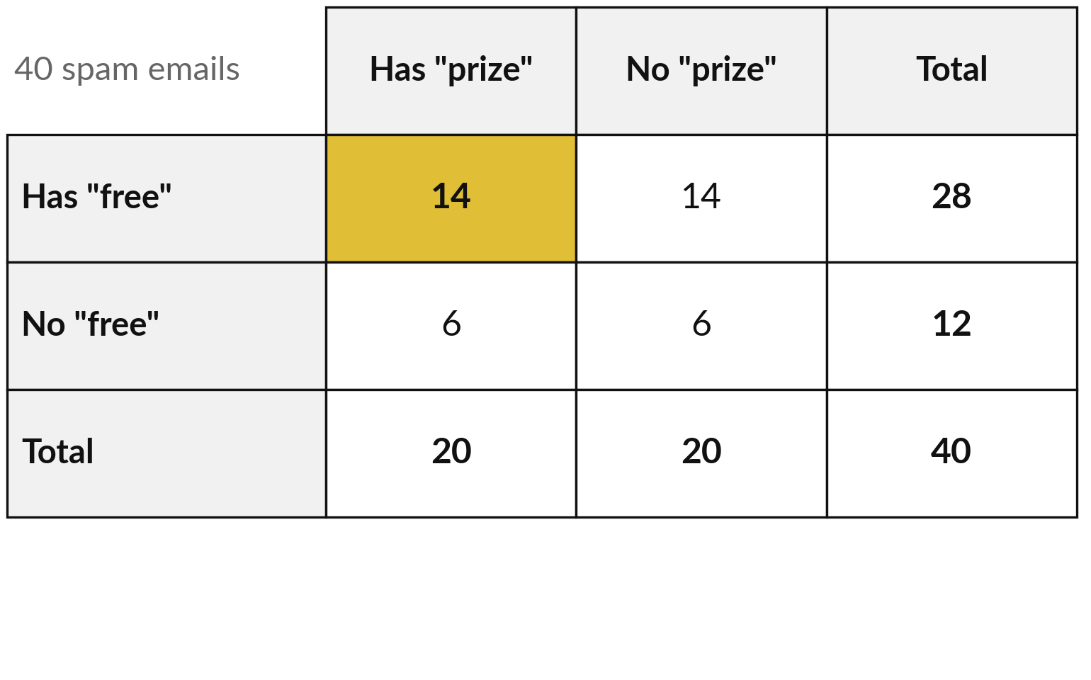
Conditional independence: within spam, "free" and
"prize" are independent, though overall they are not
Illustrative split of the 40 spam emails by both words.
Spam only: 14/40 = 0.70 × 0.50.
All 100: 0.14, not 0.34 × 0.20.
Independent within the class only.
Notes:
Naive Bayes needs a sharper kind of independence. This illustrative table splits the forty spam emails by both words. Fourteen have free and prize. Within spam, the probability of both is 14 over 40, 0.35, and that equals 0.7 times 0.5, the two separate within-spam probabilities. So within spam the words are independent.
Now look across all hundred emails. Both words appear together in 14 of 100, 0.14, but 0.34 times 0.2 is only 0.068, so overall they are dependent: both point to spam. Independent once the class is known is called conditional independence. Naive Bayes assumes it for every word in each class.

Slide 18
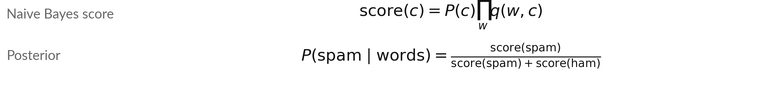
Naive Bayes: multiply the prior
by one likelihood per word
Symbol | What it means | In our data
P(c) | The prior of the class c (spam or ham). | 0.4 and 0.6
q(w, c) | The factor for word w: the smoothed likelihood P(w | c) if w is in the email, 1 - P(w | c) if not. | one per word
∏ over w | Capital pi: multiply over all the words, as Σ adds. | three words
Naive: within each class the words are treated as independent (conditional independence).
Notes:
Naive Bayes in one formula. For each class, multiply the prior by one likelihood for each word. The capital pi sign means multiply over all the words, the way sigma means add. A word that is present contributes its likelihood. A word that is absent contributes one minus its likelihood.
The word naive refers to the simplifying assumption: given the class, the words are treated as independent, which is the conditional independence we just met. Real words are not quite independent even within a class, but the assumption makes the arithmetic tiny. The posterior is the spam score divided by the sum of both scores. Two emails by hand come after this.

Slide 19
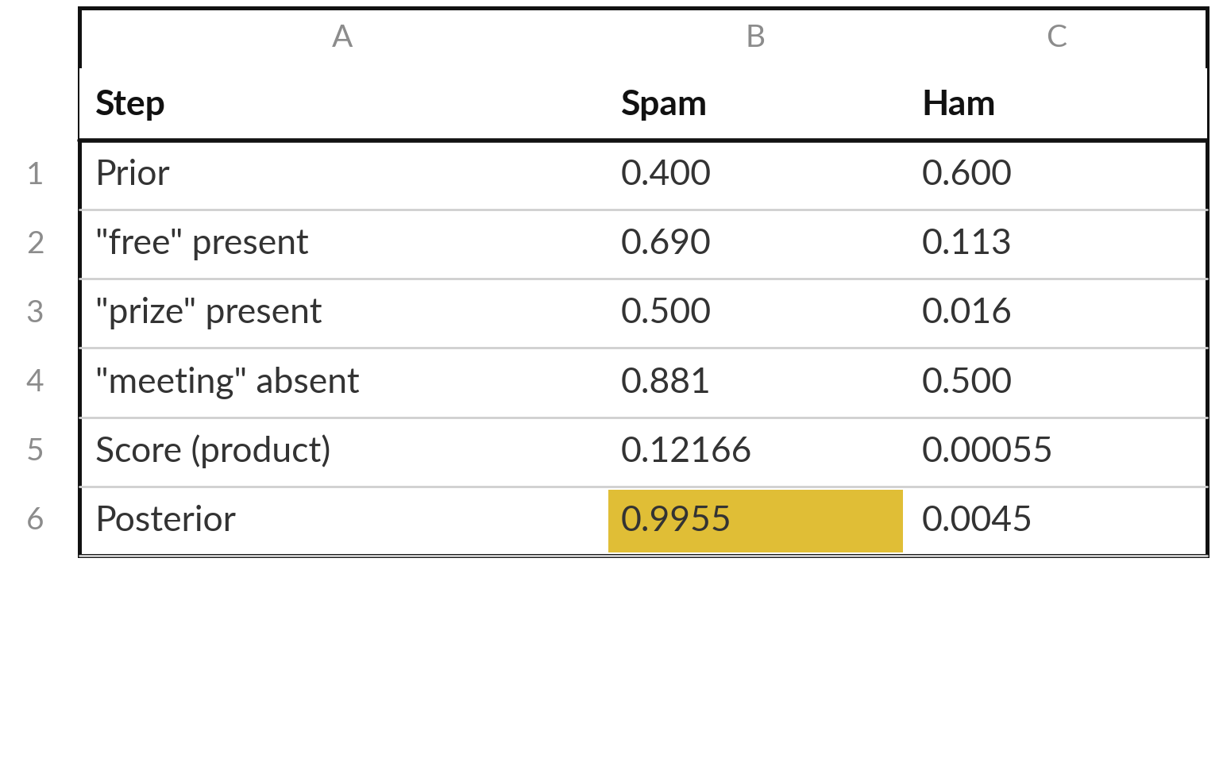
By hand, email 1 has "free" and "prize" but
no "meeting": spam with probability 0.9955
Multiply down each column, then divide the spam score by the total.
Spam score 0.12166. Ham score 0.00055.
Posterior = 0.12166 / 0.12220 = 0.9955.
Strong evidence: spam by a wide margin.
Notes:
Email one contains free and prize, but not meeting. Start each column with the prior. Multiply by the likelihood of free, then of prize, then by one minus the likelihood of meeting, because meeting is absent. Spam comes to 0.12166. Ham comes to a tiny 0.00055, dragged down by prize, which almost never appears in ham.
Divide the spam score by the total and the posterior is 0.9955. The filter is very sure this one is spam.

Slide 20
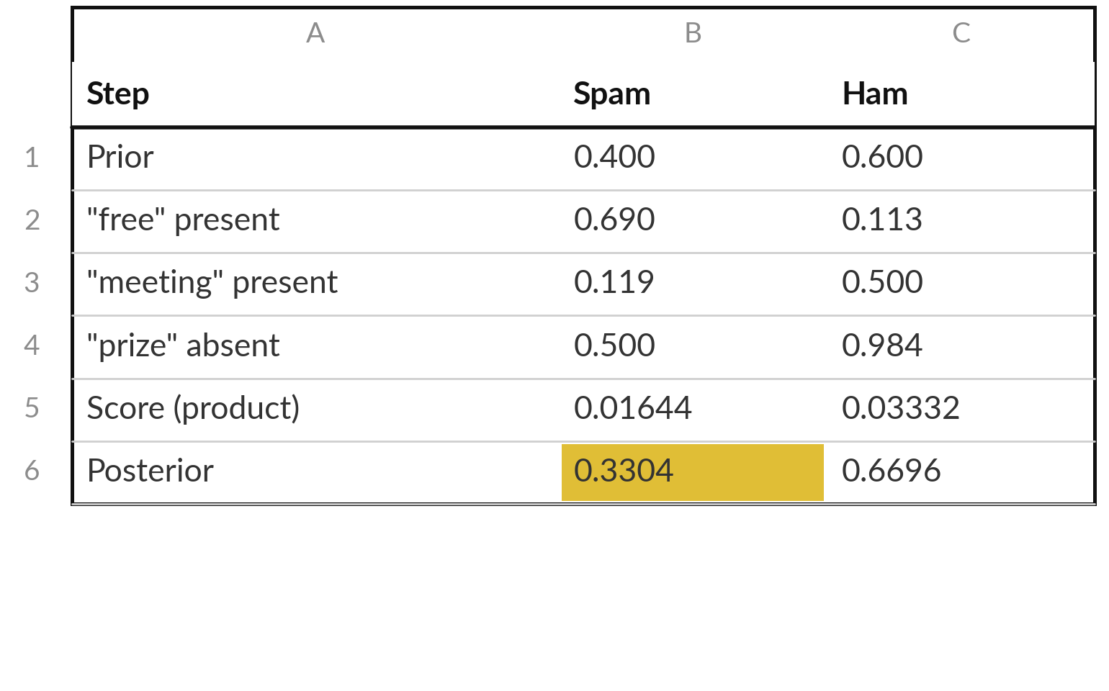
Email 2 has "free" and "meeting" but no
"prize": the filter leans to ham (33% spam)
Same method. The word "meeting" and the missing "prize" now point to ham.
Spam score 0.01644. Ham score 0.03332.
Posterior = 0.01644 / 0.04976 = 0.3304.
Not sure: about one chance in three of spam.
Notes:
Email two says free lunch at the meeting. It contains free and meeting, but not prize. The same method. Multiply the prior by 0.690 for free, 0.119 for meeting, and one minus 0.5 for the missing prize. Spam scores 0.01644. For ham we have 0.113 for free, 0.5 for meeting and 0.984 for the missing prize, and the score is 0.03332.
The posterior for spam is 0.3304. A real filter would use a threshold, say flag above 0.9, so this email goes to the inbox. Which words pushed it towards ham?

Slide 21
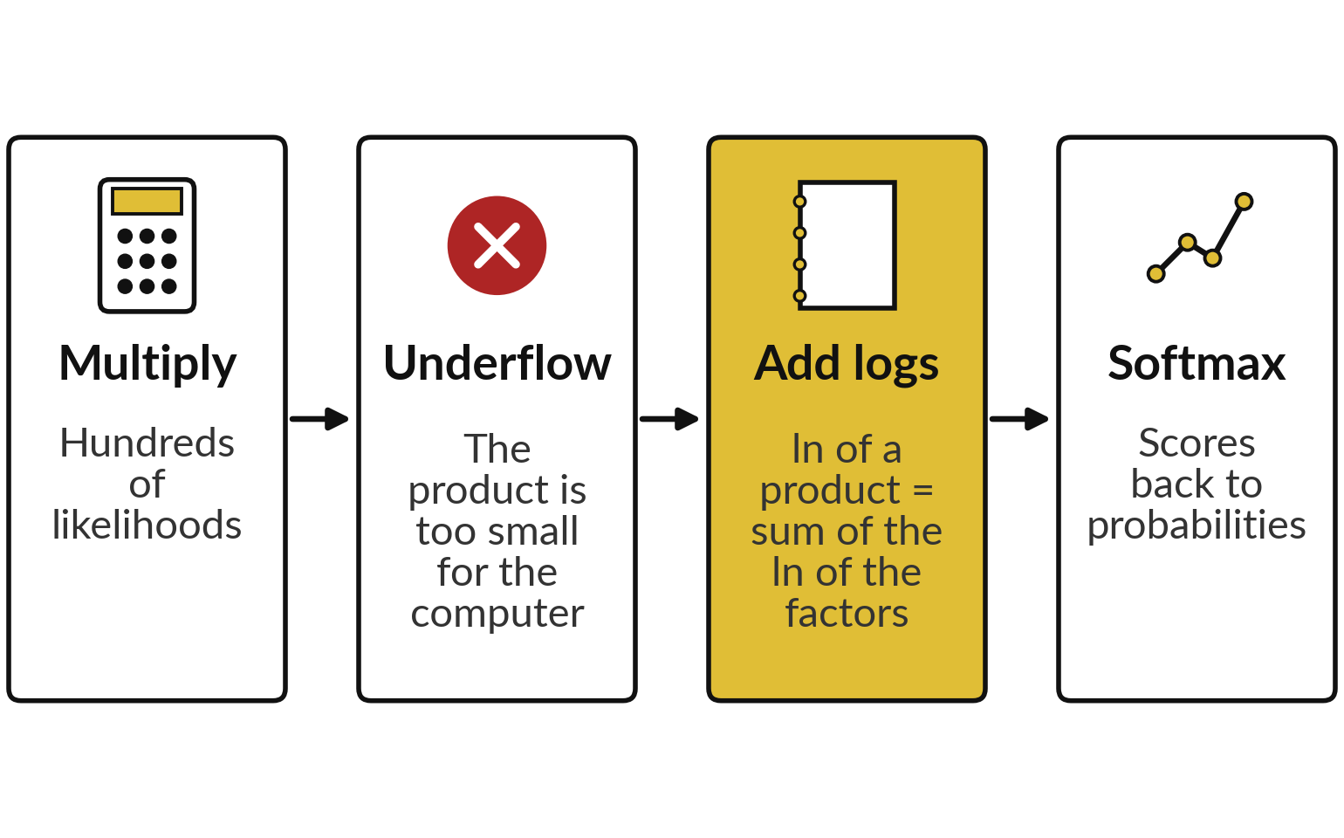
Many words multiply many small
numbers, so we add logarithms instead
Logarithms (Session 1) and the stable softmax (Session 12) fix it.
ln(score(spam)) = -2.107. ln(score(ham)) = -7.512.
Softmax of the two: 0.9955, the same posterior.
Two classes: softmax = sigmoid (Session 11) of the gap, 1 / (1 + e^(ln ham - ln spam)).
Notes:
A real spam filter uses thousands of words, so it multiplies thousands of numbers below one, and the product underflows to zero. The fix uses two tools from earlier sessions. The logarithm of a product is the sum of the logarithms, so we add instead of multiplying. Then softmax, in its stable form, turns the log scores back into probabilities.
For email one the log scores are -2.107 and -7.512, and softmax gives 0.9955, the same posterior, now safe for long emails. With only two classes the softmax simplifies to the sigmoid of Session 11: one over one plus e to the power of the ham log score minus the spam log score.

Slide 22
Bridge: Naive Bayes from counts in NumPy
In plain words
spam = np.array([28, 20, 4])
ham = np.array([6, 0, 30])
ls = (spam + 1) / 42
lh = (ham + 1) / 62
has = np.array([1, 1, 0])
ps = 0.4 * np.prod(np.where(has == 1, ls, 1 - ls))
ph = 0.6 * np.prod(np.where(has == 1, lh, 1 - lh))
ps / (ps + ph)
Lines 1 and 2: the word counts for free, prize and meeting.
Lines 3 and 4: smoothed likelihoods.
Line 5: 1 if the word is in the email, 0 if not.
Lines 6 and 7: where picks the likelihood if present, one minus it if absent. prod multiplies.
Line 8: the posterior of spam.
Notes:
The same filter in code. The counts go into two arrays, and the smoothed likelihoods are one line each. A vector called has records which words are in the email. The where function picks the likelihood for a present word and one minus the likelihood for an absent word, and prod multiplies them.
Then we multiply by the prior. The last line divides the spam score by the total, and for has equal to 1, 1, 0 it gives 0.9955. In the spreadsheet you build the same steps in a table.

Slide 23
Part 2: the lab
Close the slides. Open the notebook or the workbook.
Notes:
That is the end of the concepts. Please open either the Python notebook or the spreadsheet workbook. Both use the same counts and the same two emails. In each step, predict first, then run, then read the output, then change one thing. I will walk around. Raise your hand if a cell gives an error.

Slide 24
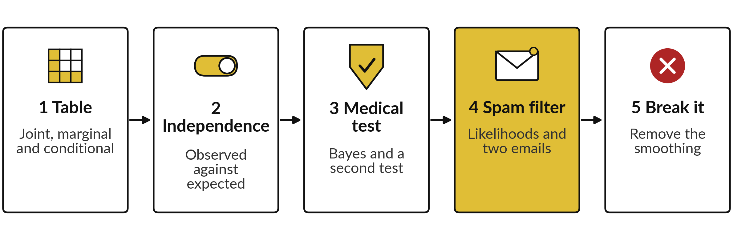
The lab has five stages, in
Python and in the spreadsheet
Python notebook: Session 15. Workbook sheets: Counts, Medical and NaiveBayes. Predict first, run, read, then change one thing.
Notes:
Five stages. Stage one, joint, marginal and conditional probabilities from the table of counts. Stage two, a check of independence. Stage three, the medical test with Bayes theorem, and a second test. Stage four, the Naive Bayes filter: smoothed likelihoods and the posteriors of two emails. Stage five, take away the smoothing and watch the filter become overconfident.
The workbook has a sheet for each, with gold cells to fill.

Slide 25
Check your numbers against
these before you move on
What you compute | You should see
P(spam and free), P(free), P(spam | free) | 0.28, 0.34, 0.8235
P(free | spam) | 0.70
Expected spam emails with "free" if independent | 13.6
Medical test: P(E), posterior after one positive test | 0.108, 0.0833
Posterior after a second independent positive test | 0.45
Smoothed likelihood of "free" in spam and of "prize" in ham | 0.6905, 0.0161
Posterior spam probability of email 1 and email 2 | 0.9955, 0.3304
CHANGE task: email 1 with no smoothing | 1.0000 (overconfident)
If your number differs, stop and find the step that went wrong. Do not change a number to match.
Notes:
Use this table as your checkpoint. Each row names what you compute and the number you should see. The conditional probabilities come from the table of counts. The medical posterior is 0.0833 after one positive test and 0.45 after two. The two spam posteriors are 0.9955 and 0.3304.
The last row is the experiment where you remove the smoothing: the filter becomes certain, which is a warning. If a number differs, stop and call me.

Slide 26

Errors you will meet, what
they mean and what to do
Where | What you see | What to do
Both | P(spam | free) is 0.7 | You divided by 40 instead of 34. Divide by the emails with the condition.
Both | Posterior 0.0900 instead of 0.0833 | You used 0.1 as P(E). Add both routes: 0.9 × 0.01 + 0.1 × 0.99 = 0.108. (Forgetting the false positives gives 1.0.)
Python | Email 1 comes out as ham | The two choices in np.where are swapped. Present (has == 1) takes the likelihood, absent takes 1 minus it.
Spreadsheet | Posterior above 1 | The ham score was not added to the denominator.
Both | Likelihood of an absent word is wrong | Use 1 - P(word | class) for a word that is not in the email.
Notes:
The errors you will probably meet. If P of spam given free comes out as 0.7, you divided by the number of spam emails instead of the number of emails with the word. If the posterior is 0.09 instead of 0.0833, you used 0.1 as the evidence, so add both routes to a positive test.
Forgetting the false positives altogether would give 1.0. If email one comes out as ham, the two choices inside np.where are the wrong way round. A posterior above one means the denominator is missing the ham score. And for an absent word, use one minus the likelihood. Read the message first.

Slide 27
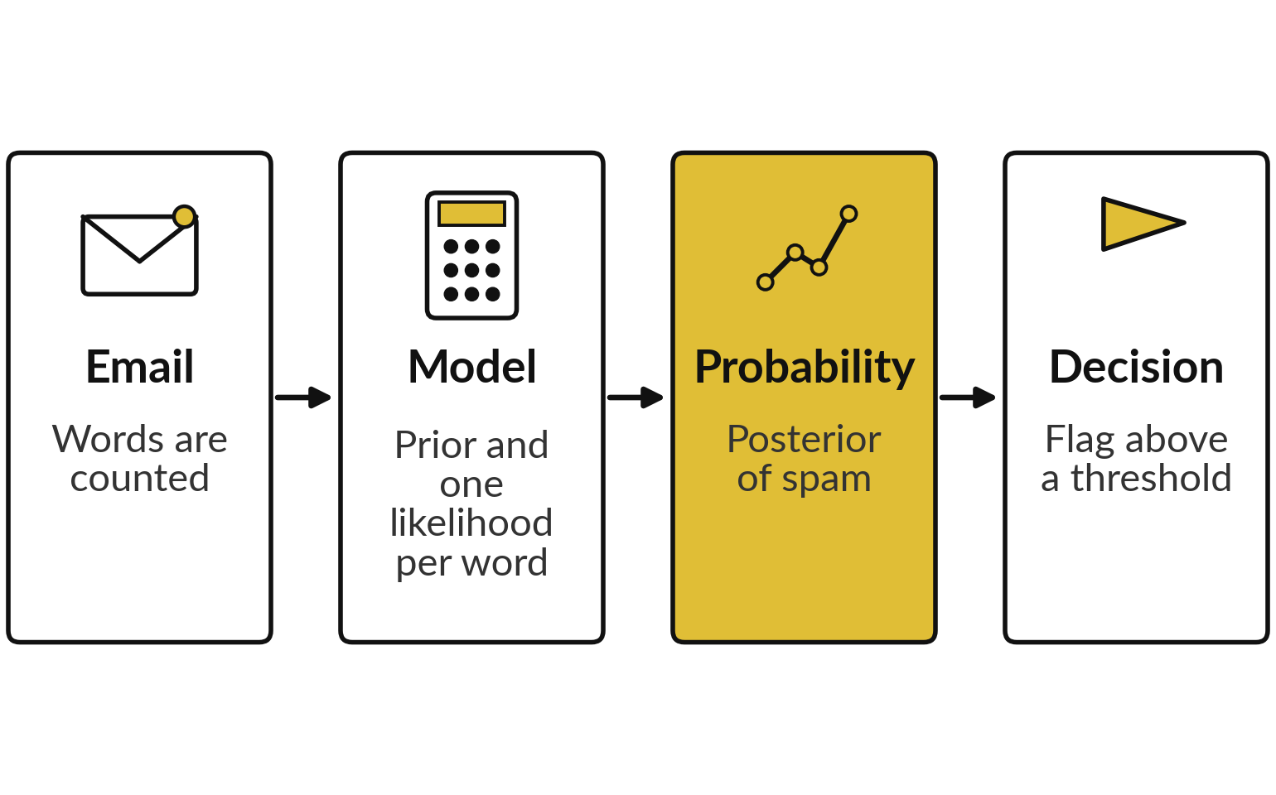
Where this appears in AI: spam
filters and medical-risk classifiers
A prior, likelihoods and a posterior run in many classifiers.
Sahami and colleagues published Bayesian junk email filtering in 1998.
A medical-risk classifier needs the base rate too.
Chat assistants are language models, not Naive Bayes.
Notes:
Today in real systems. Spam filtering with Bayes rule was published by Sahami and colleagues in 1998, and the pattern of a prior, likelihoods and a posterior sits in many classifiers since. A medical-risk classifier works the same way: its probability needs the base rate to mean anything.
Chat assistants such as ChatGPT, Gemini and Claude are not Naive Bayes classifiers. They are language models, but they still output probabilities, and the next two slides show how to read those.

Slide 28
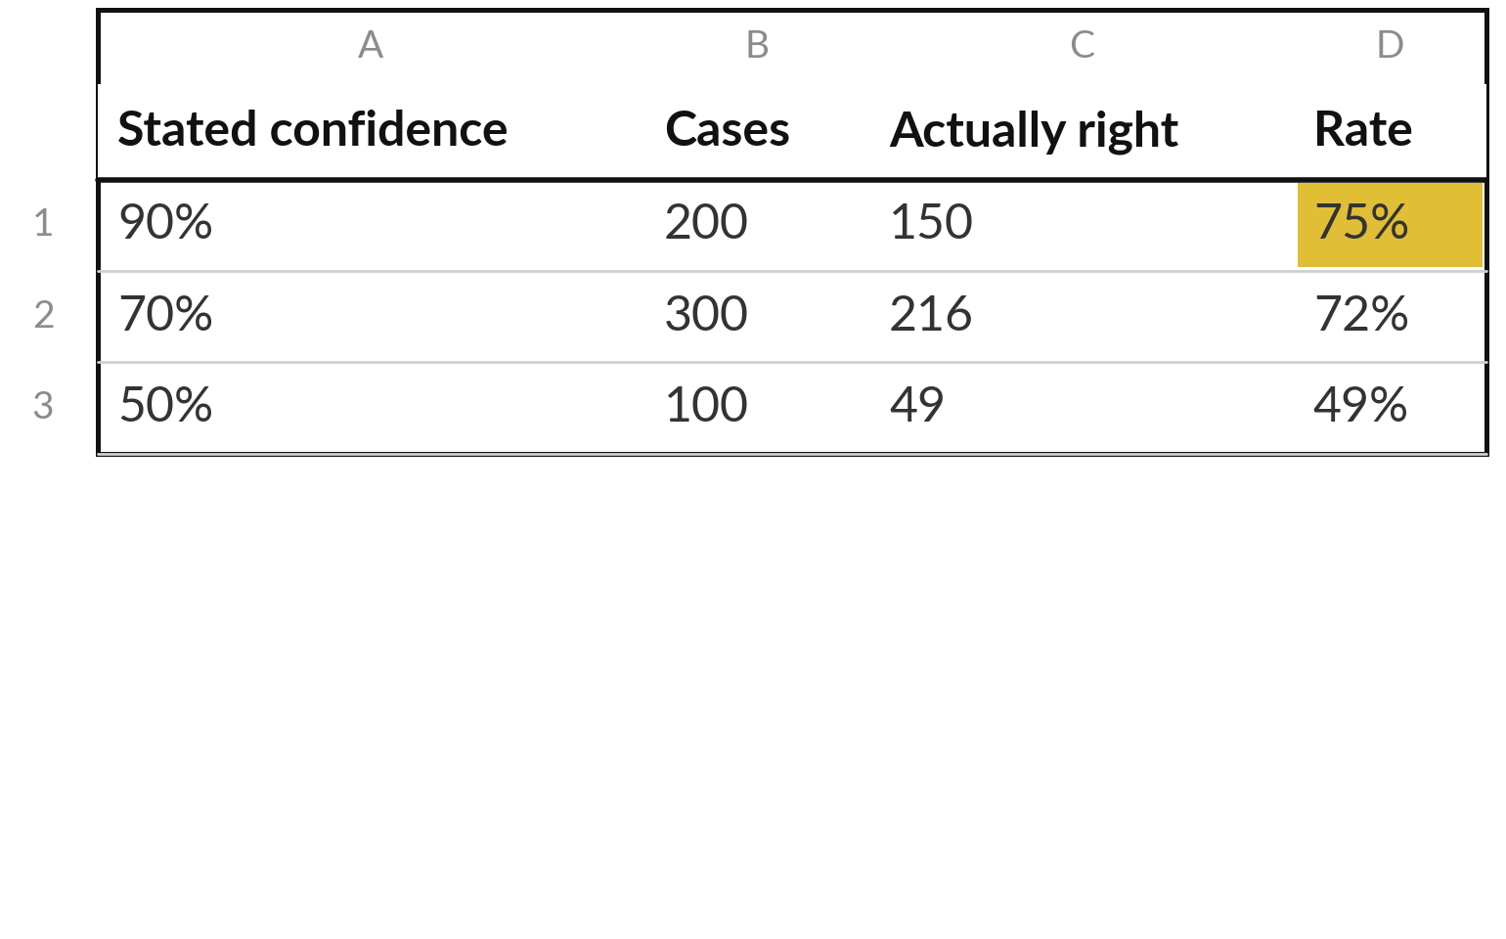
Where this appears in AI: a stated probability
should be checked against how often it is right
Illustrative (made-up) check: the model says 90% but is right 75% of the time.
Calibrated: stated probability equals the hit rate.
Guo and colleagues, 2017: many neural networks are over-confident.
Notes:
How should you read a probability from a model?
Compare it with how often the model is right. This table is illustrative. Among 200 cases where the model said ninety percent, it was right 150 times, which is 75 percent. That model is over-confident. When stated probability matches the observed rate, we say the model is calibrated.
Guo and colleagues reported in 2017 that many modern neural networks are over-confident. So a ninety percent from a model is not a guarantee. It is a claim to be tested against a record of outcomes.

Slide 29


Where this appears in AI: a fluent
answer is not a probability that it is true
What the model computes
What it does not give you
The probability of the next token given the text
High for a likely wording
The probability that the statement is true
A warning that a fluent sentence is false
Survey: Ji and colleagues, 2023
Check important claims against a source or your own calculation.
Notes:
A caution that matters for everything you do with language models. A model computes the probability of the next token given the text so far. A high probability means the wording is a likely continuation. It does not mean the statement is true. Researchers have documented fluent but false answers, often called hallucinations, and a 2023 survey by Ji and colleagues in ACM Computing Surveys reviews them.
So the fluency of an answer is not evidence. For important claims, check a source or redo the calculation, just as you did with the medical test. Which of your own uses of an assistant needs this check?

Slide 30
Where this appears in AI: check
an assistant on the medical test
8 minutes
Check an AI assistant
Ask an AI assistant the medical test question with our made-up numbers.
You keep
A note: its answer, the correct 8.3%, and what its confidence meant.
Say: 1% are sick, 90% of sick people test positive, and 10% of healthy people do too.
Ask: I tested positive. How likely am I sick?
Compare with 9 / 108 = 0.0833.
Ask how sure it is.
Notes:
A short activity. Give any AI assistant the medical test numbers, one percent prevalence, ninety percent of sick people found, ten percent of healthy people flagged, and ask how likely you are to be sick after a positive test. The right answer is 9 out of 108, 0.0833.
See whether the assistant gets it, and whether it shows its steps. Then ask how sure it is, and think about what that statement means. Use only made-up numbers like these, and never paste confidential data.

Slide 31
Exit check: three questions
Question | Short answer
In the 100 emails, P(free | spam) = 0.70 and P(spam | free) = 0.82. Why do they differ? | They condition on different groups: 40 spam emails against 34 emails with the word.
A disease affects 1 in 1,000. A test finds 99% of sick people and wrongly flags 1% of healthy people. Roughly how likely is a positive person to be sick? | About 9%. Of 1,000 people, about 1 sick positive and about 10 healthy positives: 1 / 11.
A language model gives a fluent answer. Is that the probability that it is true? | No. It reflects how likely the wording is. Check the claim.
Notes:
Three questions to finish. First, the two conditional probabilities differ because they restrict to different groups: forty spam emails against 34 emails with the word. Second, a disease in one in a thousand, with a test that finds 99 percent and flags one percent of healthy people. Of a thousand people about one sick person tests positive and about ten healthy people do, so roughly one in eleven, about nine percent.
Third, a fluent answer is not the probability that it is true. Write your answers in your lab file.

Slide 32
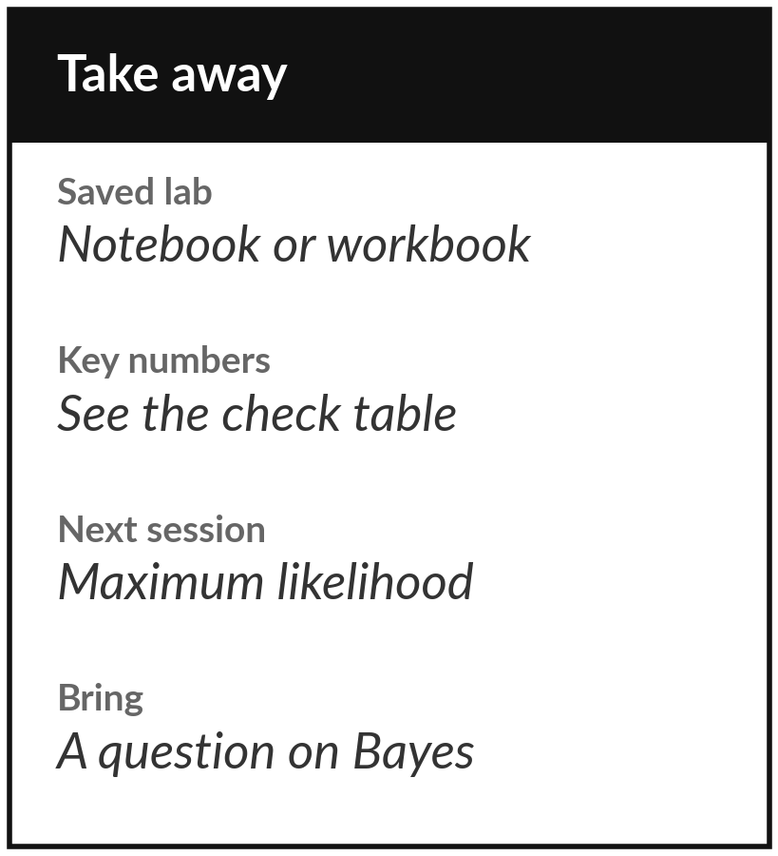
Save the lab and keep your key numbers
What you keep from today
Keep your saved lab and these numbers: P(spam given free) = 0.8235, the medical test posterior 0.0833, and the spam posteriors 0.9955 and 0.3304.
Our question today
A test finds 90% of sick people and wrongly flags 10% of healthy people. You test positive. How likely are you sick?
Next session
Session 16: maximum likelihood and MAP. We see why squared error and cross-entropy are the right losses.
Notes:
Before you go, save your notebook or workbook and keep the key numbers from the check table. Next session is maximum likelihood and MAP. Today you met the prior, the likelihood and the posterior, and in Session 16 they become the language for training a model, including why weight decay is a prior.
If the medical test result is still surprising, write your question down and bring it.
We began with this question: A test finds 90% of sick people and wrongly flags 10% of healthy people. You test positive. How likely are you sick? Before you go, say in one sentence what you can now say about it.

